Slide 1

Year-End Review Gustavo Fernandez, Wireless System Engineer
Focus Areas :
Wireless network setups, documentation, troubleshooting and optimizations.
Network Health monitoring dashboard.
Connectivity solutions (robot modem integration).

Slide 2
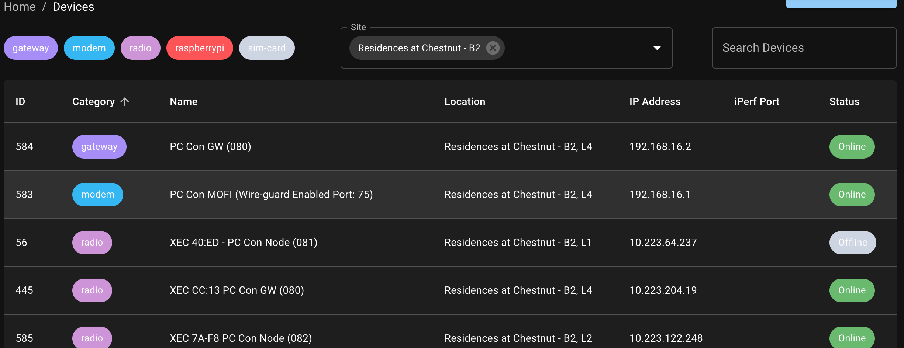
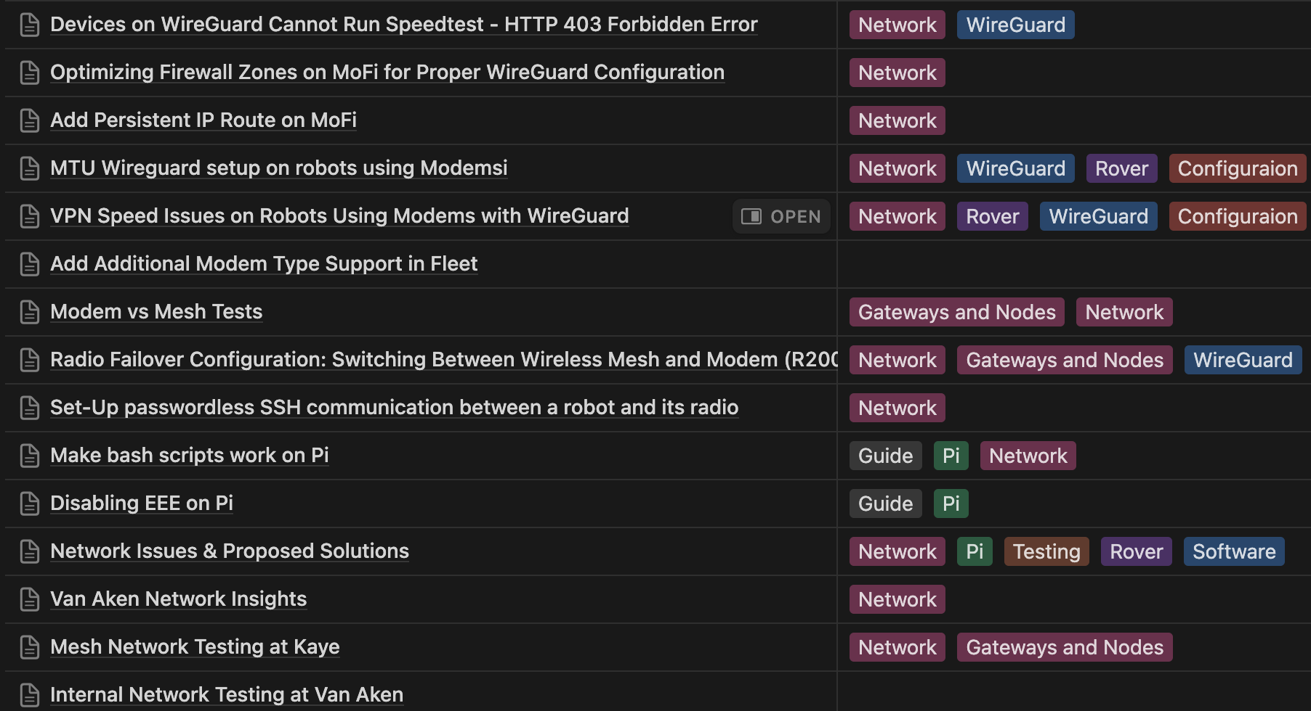
Wireless Network Setup & Documentation
Delivered:
Set up and optimized wireless networks.
Documented network configuration , best practices, and troubleshooting steps.
Maintained fleet management records to ensure up-to-date information for all network elements
Impact:
Enabled robot connectivity, reduced network errors, and improved overall network performance.
Allowed the team to easily access network elements and seamlessly run operations and maintenance tasks.

Slide 3
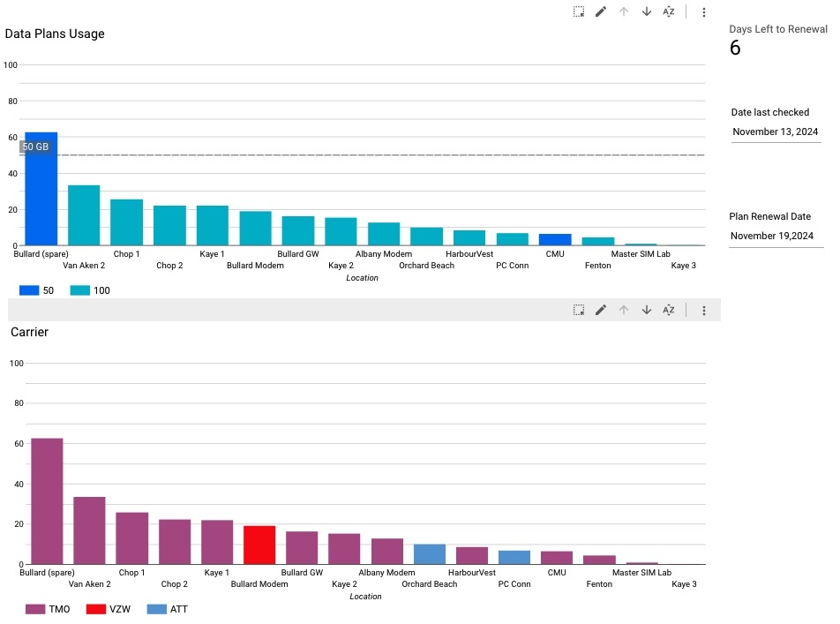
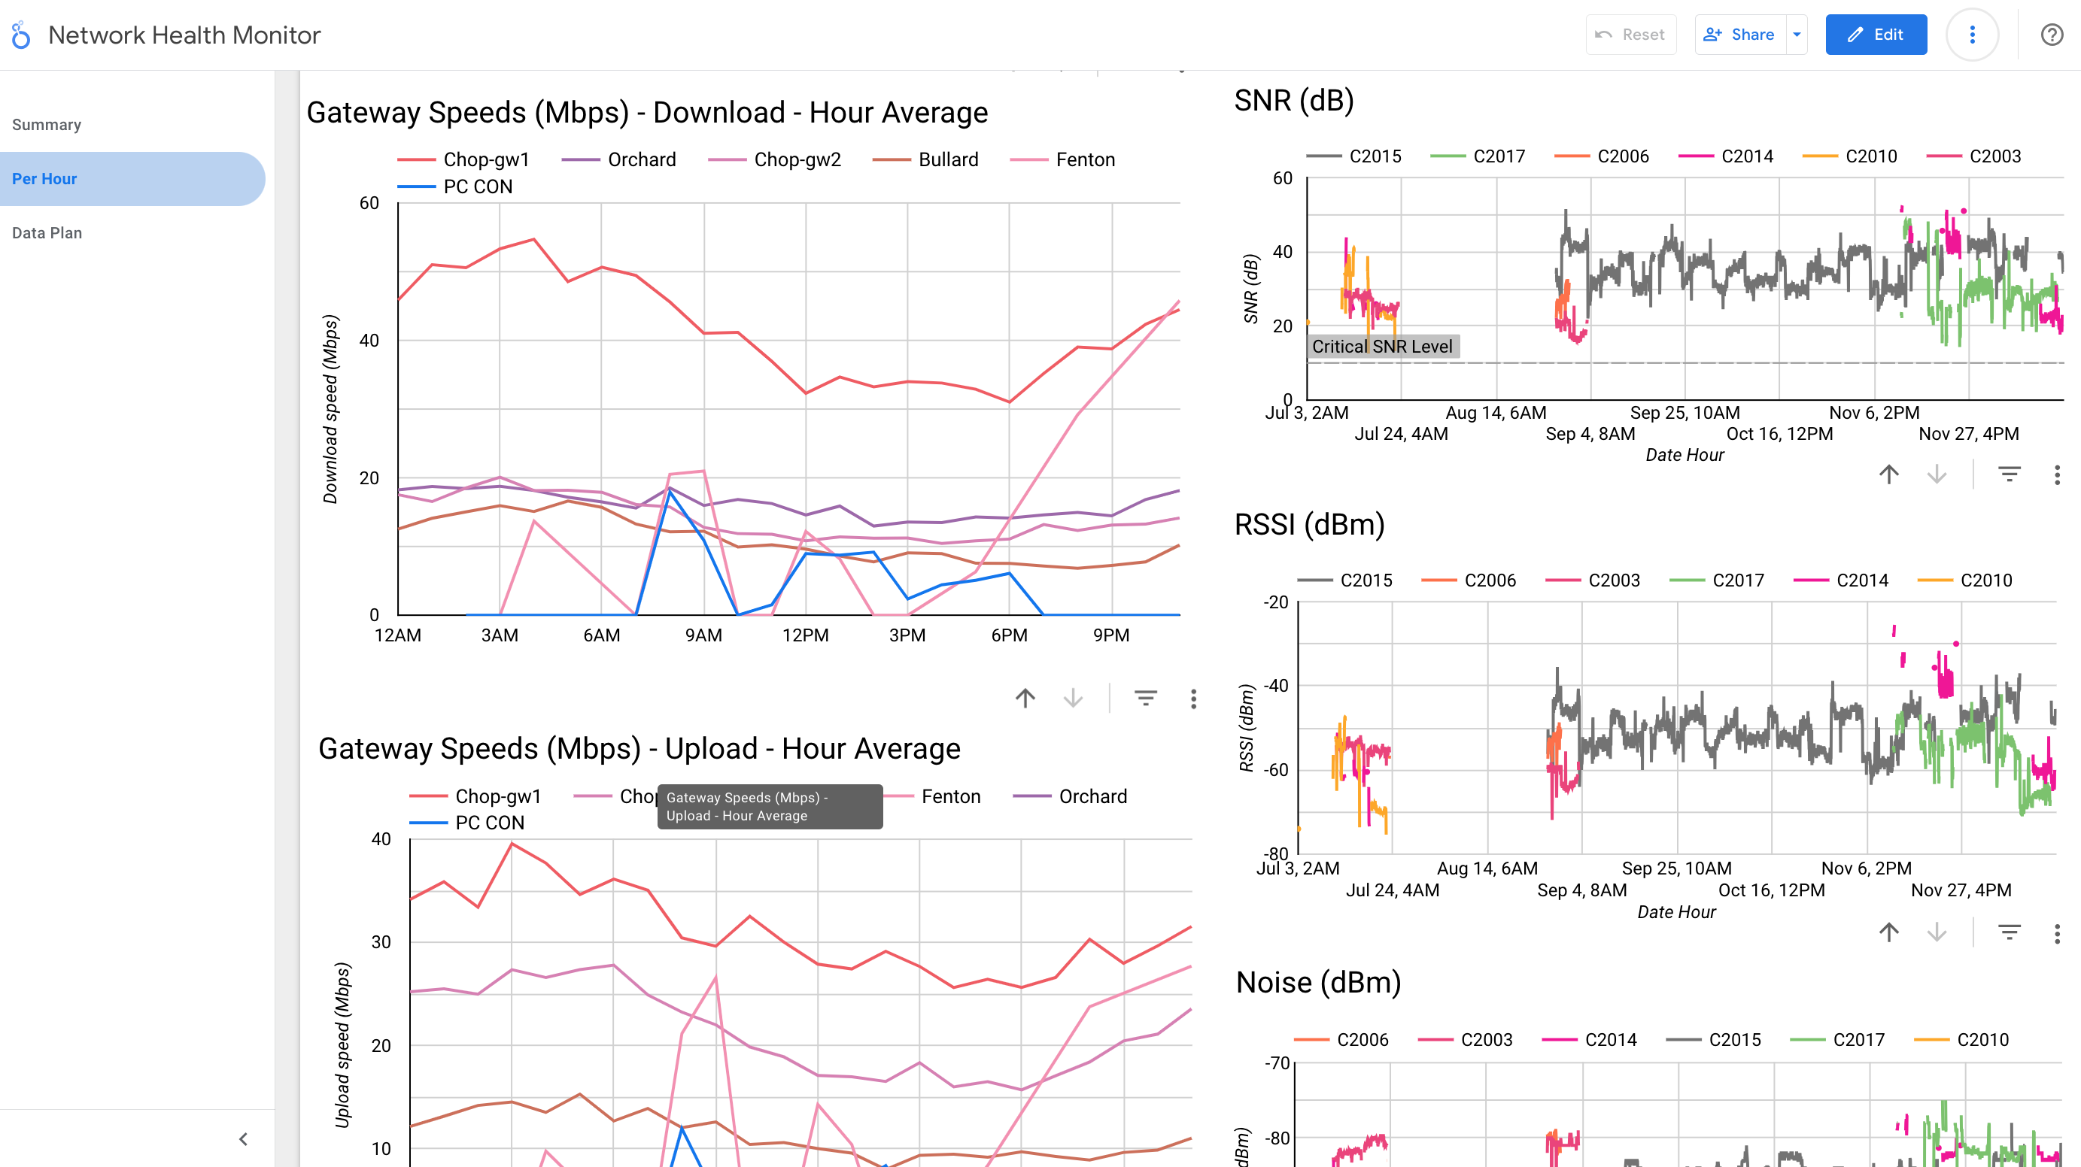
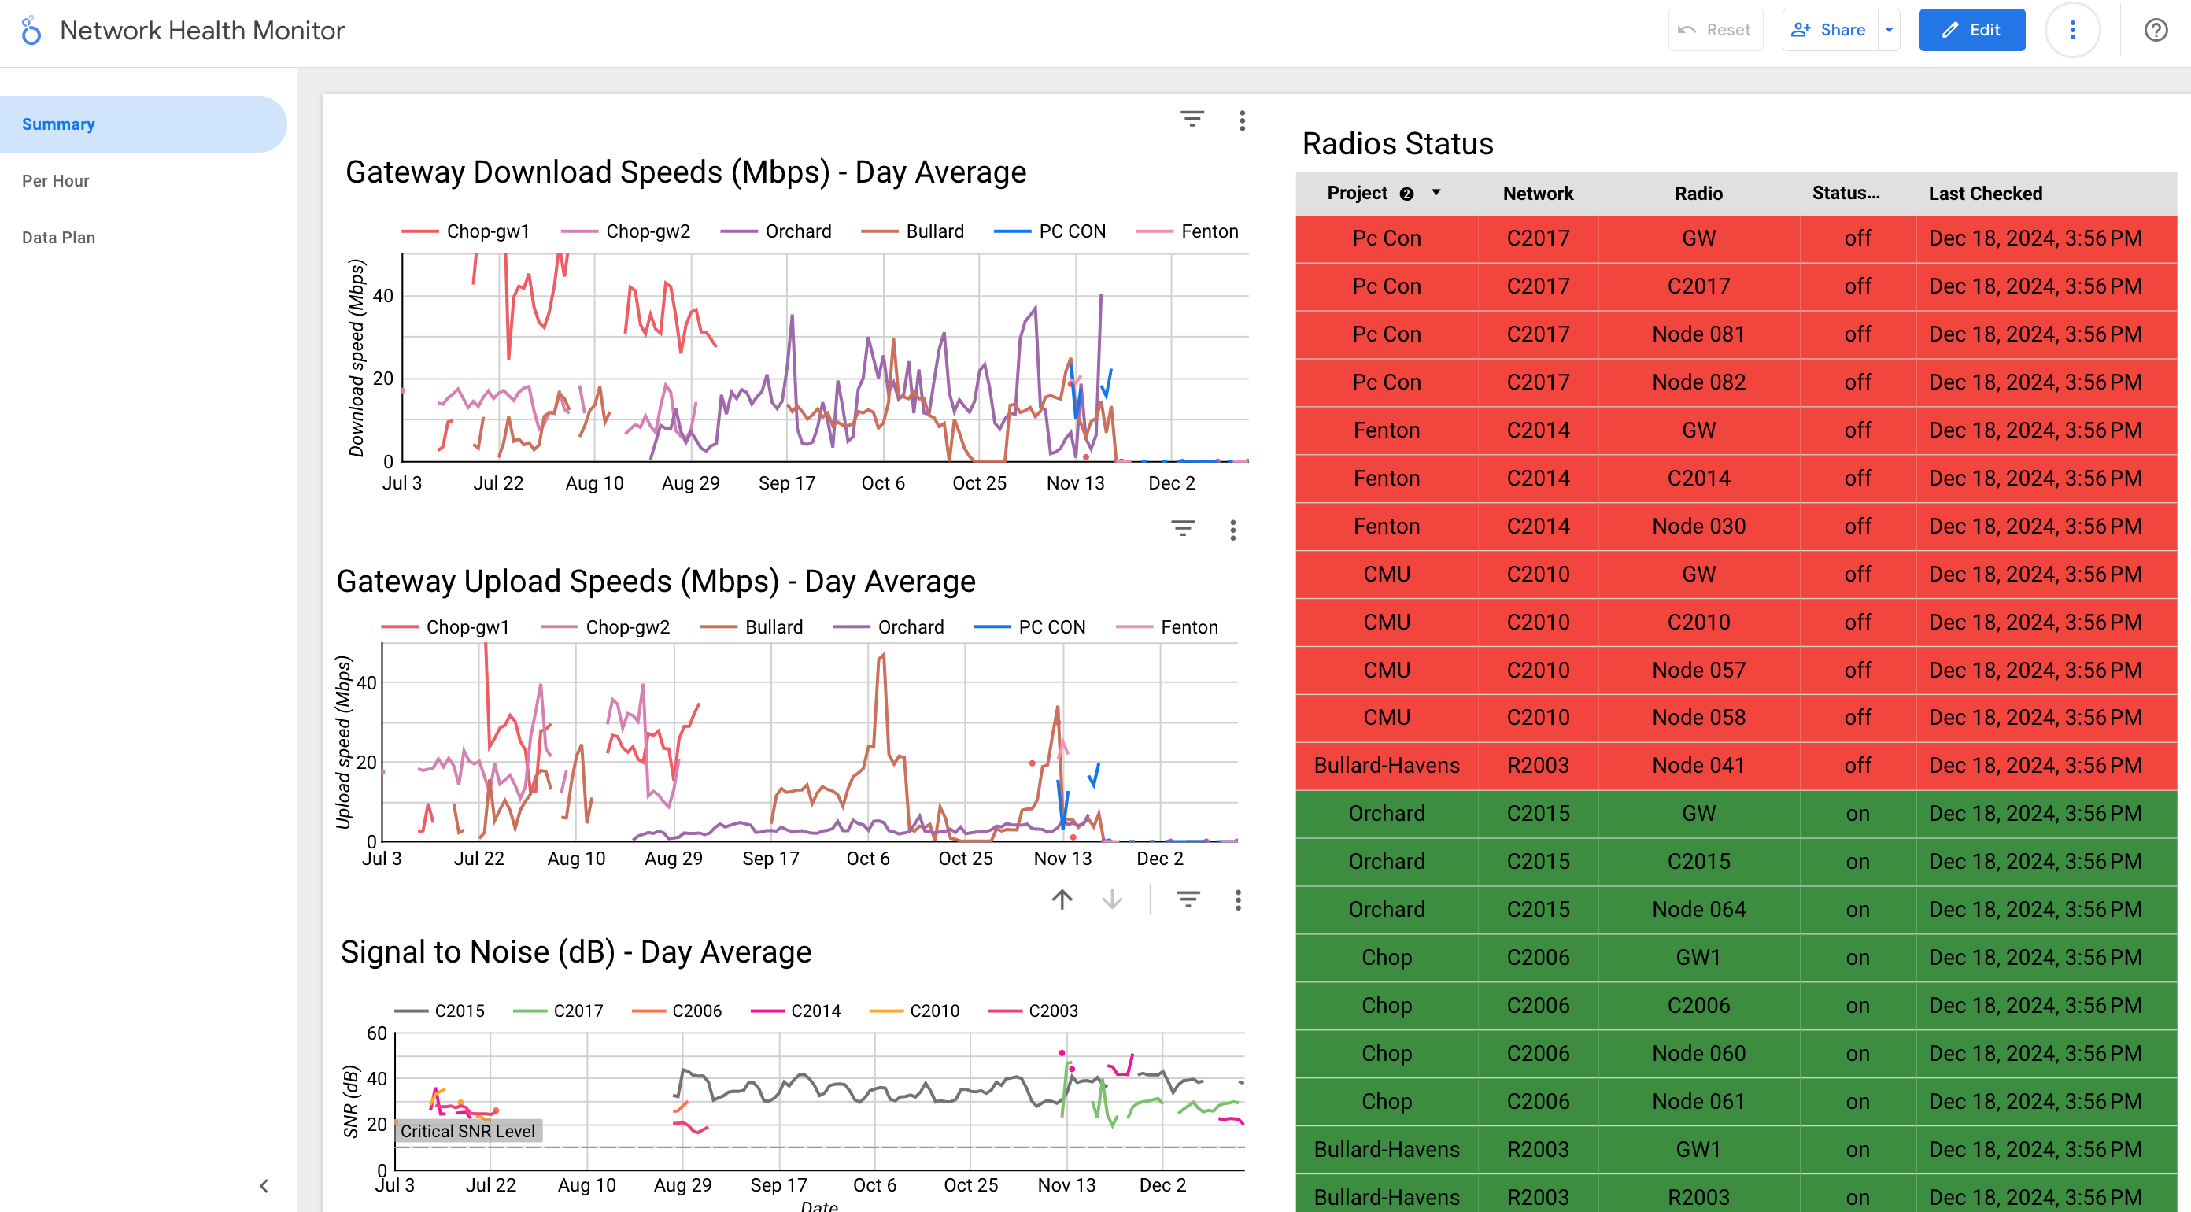
Network Monitoring Dashboard
Delivered:
Developed a comprehensive network monitoring dashboard and a suite of network scripts/tools to collect, analyze, and report on the state and performance of network elements.
Impact:
Provided immediate visibility into network health.
Facilitated proactive troubleshooting and reduced downtime.
Enabled data-driven decision-making for optimization activities.

Slide 4
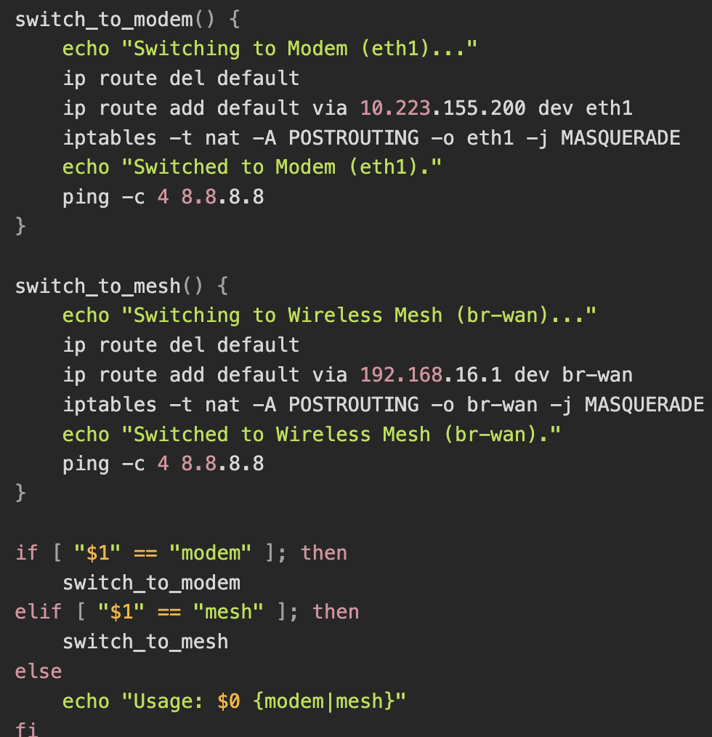
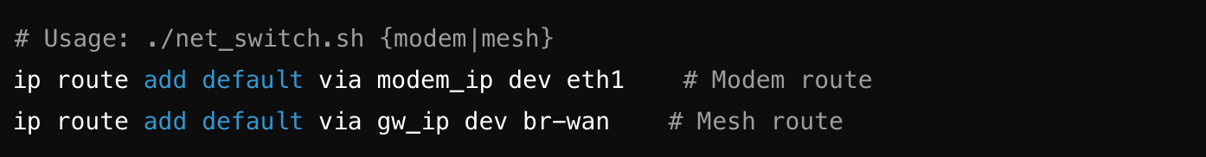
Radio Failover / Modem Integration
Delivered:
Integrated cellular modem failover to complement the wireless mesh network.
Developed a script to switch seamlessly between mesh and modem.
Impact:
Ensured continuous connectivity for robot operations by enabling the modem to serve as the primary or backup link, depending on the deployment, thus adding an additional source of connectivity and redundancy against mesh network failures.
Code Snippet

